Slide 1
Sentiment Analysis Study
Hani Amr
Software Engineer

Slide 2
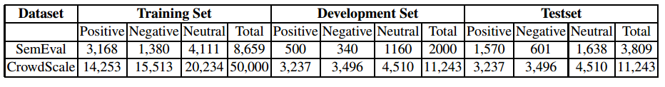
Overview
Datasets:
Classifiers:
Two-class logistic regression
Technology:
Azure Machine Learning Studio, R, Python

Slide 3
Data Preprocessing
Cleaning text:
Change negation words (not, cannot, never, etc.) to “not”
Remove numbers, Unicode characters, URLs and stop words
Replace more than 2 consecutive characters by only 2 (i.e. heeeey ➔ heey)
Replace emoticons by their polarity (i.e. :=) ➔ positive_emoticon)
Stemming using Porter’s algorithm
Tokenization using CMU tokenizer

Slide 4
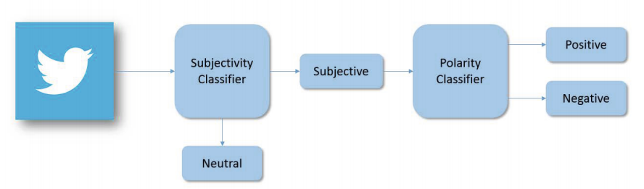
Pipeline approach

Slide 5
Feature extraction

Slide 6
Baseline features
N-Grams:
Uni/bigrams using binary word presence
Apply Log Likelihood scoring to select the top 20K ngrams
Example:
N-Gram | Score
hate | 235.0607
love | 200.4914
positive_emoticon | 167.5600
spain | 111.5650
ger | 106.3451
Germany | 93.3149
amazing | 91.9482
support | 90.7155

Slide 7
Senti-Features
Polar features:
# of (+/-) POS (JJ, RB, VB, NN)
# of negation words, positive words, negative words
# of positive and negative emoticons
# of (+/-) hashtags and capitalized words
For POS JJ, RB, VB, NN, sum of polarity scores
Sum of prior polarity for all words
Non-polar features:
# of JJ, RB, VB, NN
# of slangs, Latin alphabets, dictionary words, words
# of hashtags, URLs, mentions
Percentage of capitalized text
Exclamation, capitalized text
Notes:
JJ: Adjective
RB: Adverb
VB: Verb
NN: Noun

Slide 8
Sentiment Specific Word Embedding
RNN trained on 10M auto-labeled tweets using emoticons
For each tweet, calculate the mean/min/max and generate a feature vector of size 150
Example:
Tweet: good day everyone!
good | 0.1059199 | 0.5693018 | 0.813515 | 1.189322 | -2.537077 | 1.463798 | -0.5817627 | -1.51455
day | 0.06825718 | 0.754171 | -0.4899379 | -0.7972742 | -1.958613 | 0.5648658 | 0.3248749 | -1.03408
everyone | -1.861807 | 1.930682 | 1.772654 | 0.3432329 | -3.497849 | -0.1420933 | 0.7691697 | -0.06457
mean | -0.56254 | 1.084718 | 0.698744 | 0.245094 | -2.66451 | 0.628857 | 0.170761 | -0.87107
min | -1.86181 | 0.569302 | -0.48994 | -0.79727 | -3.49785 | -0.14209 | -0.58176 | -1.51456
max | 0.10592 | 1.930682 | 1.772654 | 1.189322 | -1.95861 | 1.463798 | 0.76917 | -0.06457

Slide 9
NRC Features
Counting features:
All-caps words
Number of occurrences of each POS tag
Number of hashtags
# of elongated words (i.e. heey)
Number of negated contexts (i.e. I don’t like Arsenal today!)
Presence in the pre-defined clusters (provided by CMU POS tagger)
Punctuation: contiguous sequences of exclamation marks, questions marks or both
Lexicon features:
Lexicon features for all tokens in the tweet, each POS, hashtags and all-caps. For each token w, calculate the following:
Total count of tokens with score(w,p) > 0
Total score for all tokens
Maximal score among all tokens
Score of the last token where score(w,p) > 0

Slide 10
Experimentation results

Slide 11
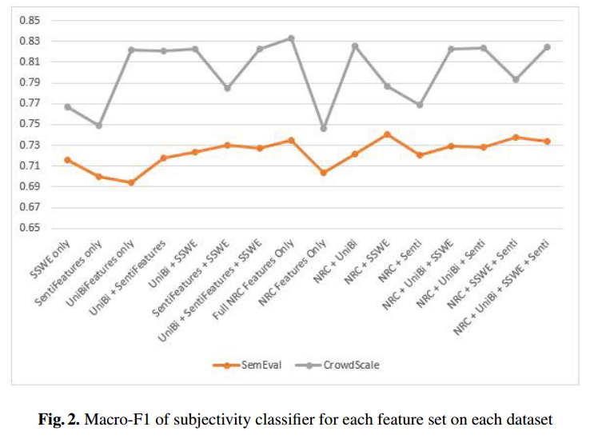
Subjectivity Classifier

Slide 12
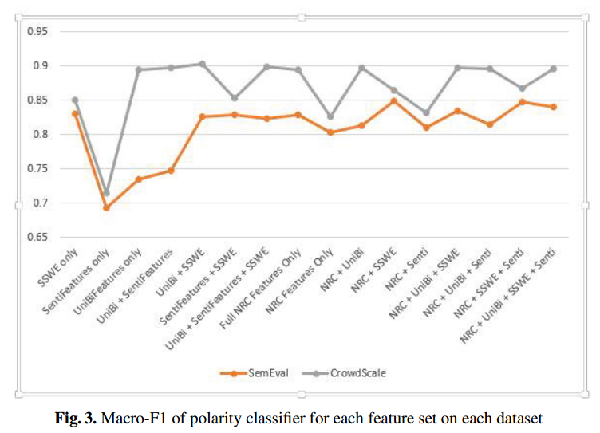
Polarity Classifier

Slide 13
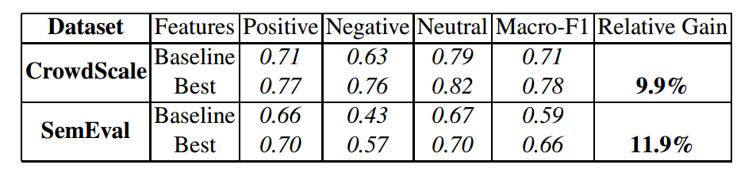
Ensemble

Slide 14
Resources
Microsoft Cognitive Services (Text Analytics API):
https://www.microsoft.com/cognitive-services/en-us/text-analytics-api
Publication:
http://rd.springer.com/chapter/10.1007%2F978-3-319-18117-2_7

